Slide 1
UNIT II
Topic: Control Structures

Slide 2
C Input Output (I/O)
<stdio.h>
The header file stdio.h stands for Standard Input Output. It has the information related to input/output functions.
(# preprocessor) The system will find the file named "stdio.h" and read its entire contents in, replacing this statement.
printf() and scanf() functions are inbuilt library functions in C programming language which are available in C library by default.

Slide 3
C Input Output (I/O)
C Output
In C programming, printf() is one of the main output function. The function sends formatted output to the screen.
The function prints the string inside quotations.
To use printf() in our program, we need to include <stdio.h> header file using the #include<stdio.h>
The return 0; statement inside main() function is the "Exit status" of the program.

Slide 4
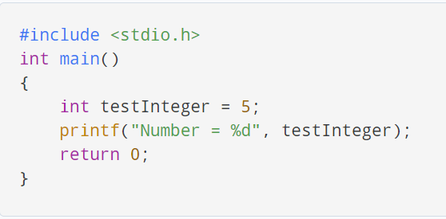
C Input Output (I/O)
C Output

Slide 5
C Input Output (I/O)
C Input
In C programming, scanf() is one of the commonly used function to take input from the user.
The scanf() function reads formatted input from the standard input such as keyboards.

Slide 6
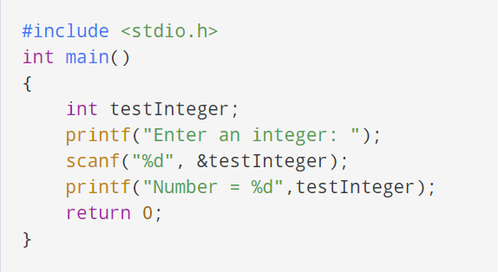
C Input Output (I/O)
C Input

Slide 7
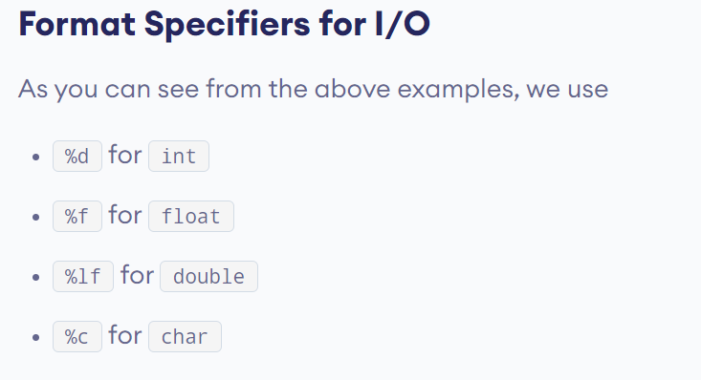
C Input Output (I/O)
C Input

Slide 8
C Input Output (I/O)
#include <stdio.h>
void main()
{
// This code will run properly
// but in the end,
// it will demand an exit code.
printf("It works fine");
}

Slide 9
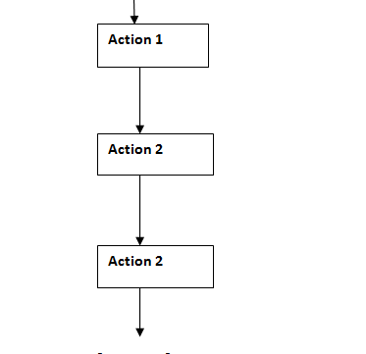
Control Structures
Control structures are used to alter the flow of execution of the program.

Slide 10
Control Structures
Control Structures are just a way to specify flow of control in programs
There are three basic types of logic, or flow of control, known as:
Sequence logic, or sequential flow
Selection logic, or conditional flow
Iteration logic, or repetitive flow

Slide 11
Control Structures
Sequence logic, or sequential flow
Follows a serial or sequential flow.
implicitly follows the order in which modules are written. Most of the processing, even some complex problems, will generally follow this elementary flow pattern.

Slide 12
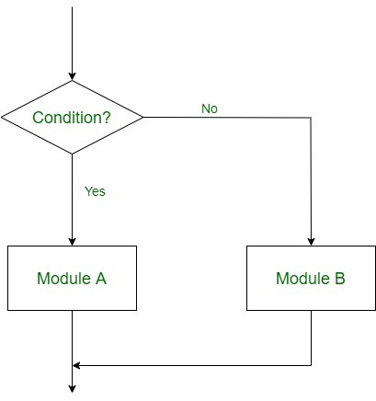
Control Structures
2. Selection logic, or conditional flow
Selection Logic simply involves a number of conditions or parameters which decides one out of several written modules

Slide 13
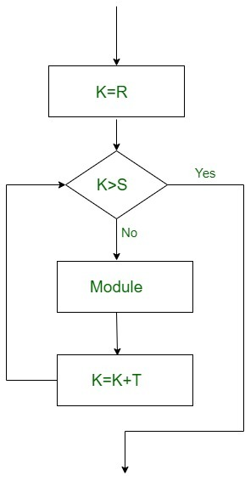
Control Structures
3. Iteration logic, or repetitive flow
The Iteration logic employs a loop which involves a repeat statement followed by a module known as the body of a loop.

Slide 14
Control Structures
The control statements are:-
Switch
If
If Else
Switch case
While
Do While
For
Selection structures are implemented using If , If Else and Switch statements.
Looping structures are implemented using While, Do While and For statements.

Slide 15
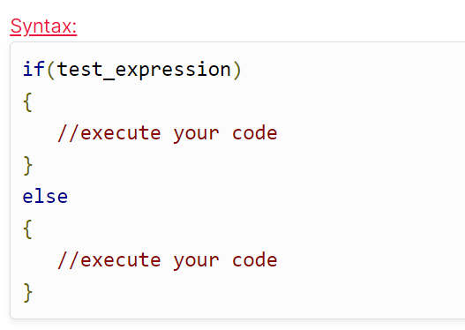
Control Structures: If-Else
The expression given inside the brackets after if is evaluated first.
If the expression is true, then statements inside the curly braces that follow if(expression) will be executed.
If the expression is false, the statements inside curly braces will not be executed, and program control goes directly to statements after curly braces.

Slide 16
Control Structures: If-Else
???
Program: (If_Else)
We will initialize a variable with some value
write a program to determine if the value is less than ten or greater than ten.

Slide 17
Control Structures: If-Else
#include<stdio.h>
int main()
{
int num=19;
if(num<10)
{
printf("The value is less than 10");
}
else
{
printf("The value is greater than 10");
}
return 0;
}
Program: (If_Else)
We will initialize a variable with some value
write a program to determine if the value is less than ten or greater than ten.

Slide 18
#include<stdio.h>
int main()
{
int num;
printf("Hello user, Enter a number");
scanf("%d",&num); // Collects the number from user
if(num==1)
{
printf("UNITED STATES");
}
if(num==2)
{
printf("SPAIN");
}
if(num==3)
{
printf("INDIA");
}
}
Control Structures: If-Else
Program: (If_Else)
If the integer entered by user is 1 – output on screen “UNITED STATES”.
If the integer is 2 – output “SPAIN”, If the integer is 3 output “INDIA”.
If the user enters some other value – output “WRONG ENTRY”

Slide 19
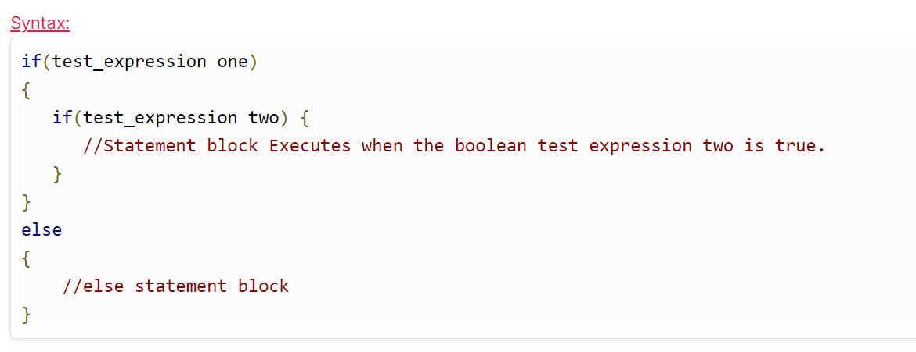
Control Structures: Nested If..else statement
When an if else statement is present inside the body of another “if” or “else” then this is called nested if else.

Slide 20
Control Structures: Nested If..else statement
#include<stdio.h>
main()
{
int x=20,y=30;
if(x==20)
{
if(y==30)
{
printf("value of x is 20, and value of y is 30.");
}
}
Program: (Nested If..else)
When an if else statement is present inside the body of another “if” or “else” then this is called nested if else.

Slide 21
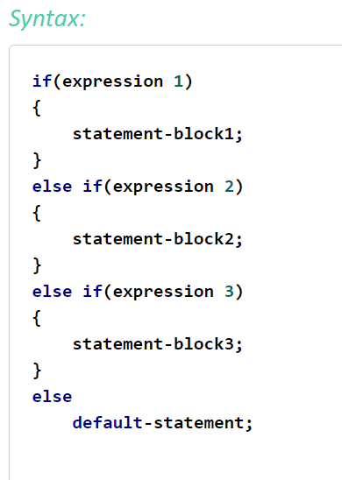
Control Structures: if-else-if ladder in C
if-else-if:
Here, a user can decide among multiple options.
The C if statements are executed from the top down. As soon as one of the conditions controlling the if is true, the statement associated with that if is executed, and the rest of the C else-if ladder is bypassed.
If none of the conditions are true, then the final else statement will be executed.

Slide 22
Control Structures: if-else-if ladder in C
// C program to illustrate nested-if statement
#include <stdio.h>
int main() {
int i = 20;
if (i == 10)
printf("i is 10");
else if (i == 15)
printf("i is 15");
else if (i == 20)
printf("i is 20");
else
printf("i is not present");
return 0;
}
Program: (If-else-if)
Write a program to check whether the number is equal to 10, 15 or 20?

Slide 23
Control Structures: if-else-if ladder in C
???
Program: (If-else-if)
Write a program to Display grades
of student ( eg:if Score greater than 75: A)

Slide 24
Control Structures: if-else-if ladder in C
if(p>=80)
printf("\n\n Your Grade : A+");
else if(p>=75)
printf("\n\n Your Grade : A");
else if(p>=60)
printf("\n\n Your Grade : B");
else if(p>=45)
printf("\n\n Your Grade : C");
else if(p>=35)
printf("\n\n Your grade : D");
else
printf("\n\n You Are Fail");
Program: (If-else-if)
Write a program to Display grades of student ( eg:if Score greater than 75: A)

Slide 25
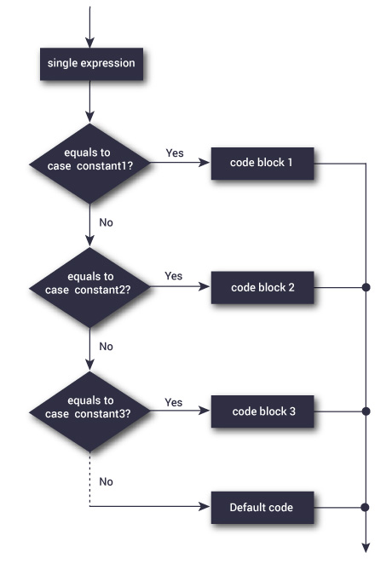
Control Structures: Switch Case
The switch statement allows us to execute one code block among many alternatives.

Slide 26
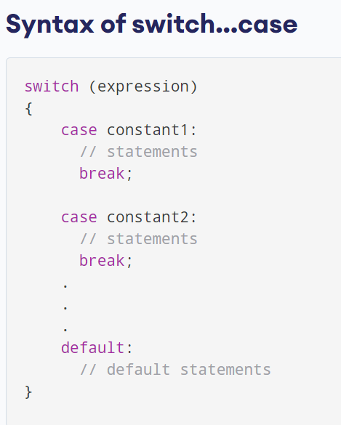
Control Structures: Switch Case
The switch statement allows us to execute one code block among many alternatives.

Slide 27
Control Structures: Switch Case
int main () {
char grade = B;
switch(grade)
{
case 'A' :
printf("Excellent!\n" );
break;
case 'B’ :
printf("Well done\n" );
break;
case ‘C' :
printf("You passed\n" );
break;
case ‘D' :
printf("Better try again\n" );
break;
default :
printf("Invalid grade\n" );
}
The switch statement allows us to execute one code block among many alternatives.
When a break statement is reached, the switch terminates, and the flow of control jumps to the next line following the switch statement.
The default case can be used for performing a task when none of the cases is true.

Slide 28
Control Structures: Switch Case
int main () {
char grade = B;
switch(grade)
{
case 'A' :
printf("Excellent!\n" );
break;
case 'B’ :
printf("Well done\n" );
break;
case ‘C' :
printf("You passed\n" );
break;
case ‘D' :
printf("Better try again\n" );
break;
default :
printf("Invalid grade\n" );
}
The switch statement allows us to execute one code block among many alternatives.
Duplicate case values are not allowed.
The default statement is optional.
The break statement is optional. If omitted, execution will continue on into the next case.

Slide 29
Control Structures: Switch Case
Program

Slide 30
Control Structures: Loops
In programming, loops are used to repeat a block of code until a specified condition is met.
C programming has three types of loops.
for loop
while loop
do...while loop

Slide 31
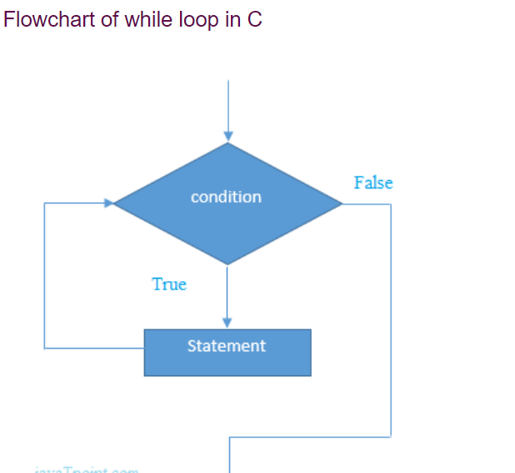
Control Structures: Loops
While loop:
Allows a part of the code to be executed multiple times depending upon a given boolean condition
Pre-tested loop
The while loop is mostly used in the case where the number of iterations is not known in advance.

Slide 32
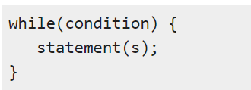
Control Structures: Loops
Syntax of While Loop:
While loop:
Allows a part of the code to be executed multiple times depending upon a given boolean condition
Pre-tested loop
The while loop is mostly used in the case where the number of iterations is not known in advance.

Slide 33
Control Structures: Loops
Syntax of While Loop:
While loop:
The while loop evaluates the test expression inside the parenthesis ().
If the test expression is true, statements inside the body of loop are executed.
Then, the test expression is evaluated again.

Slide 34
Control Structures: Loops
Syntax of While Loop:
While loop:
The process goes on until the test expression is evaluated to false.
If the test expression is false, the loop terminates (ends).

Slide 35
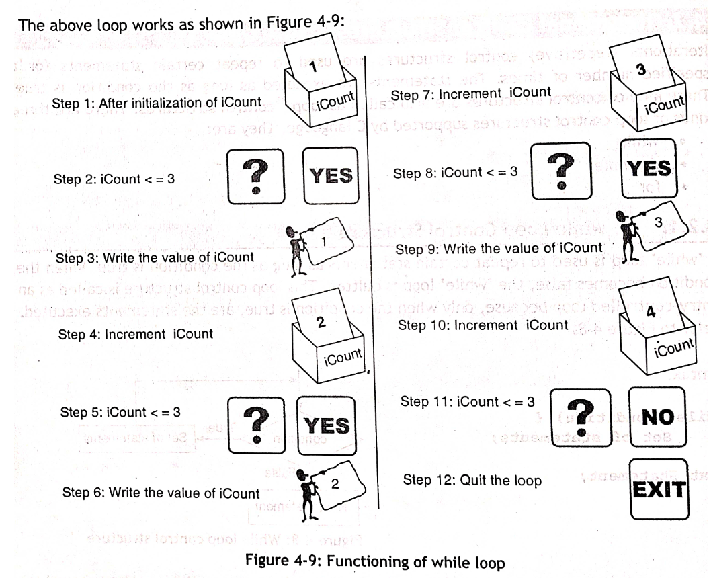
Control Structures: Loops
Functioning of While Loop:
While loop:
Display numbers from 1 to 3
int iCount=1;
while(iCount <=3)
{
printf(“%d”, iCount);
iCount=iCount+1;
}

Slide 36

Control Structures: Loops
Syntax of do While Loop:
Do While loop:
A do...while loop is similar to a while loop, except the fact that it is guaranteed to execute at least one time.

Slide 37
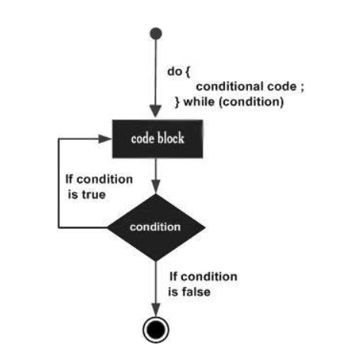
Control Structures: Loops
Flow Chart of do While Loop:
Do While loop:
If the condition is true, the flow of control jumps back up to do, and the statement(s) in the loop executes again. This process repeats until the given condition becomes false.

Slide 38
Control Structures: Loops

Slide 39
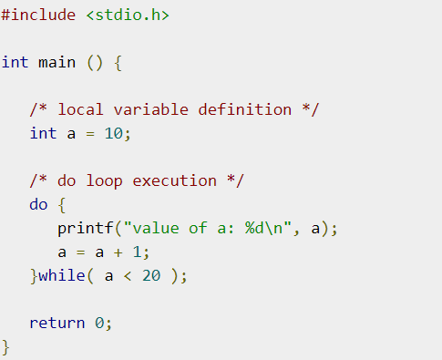
Control Structures: Loops
Do While loop:
Program

Slide 40
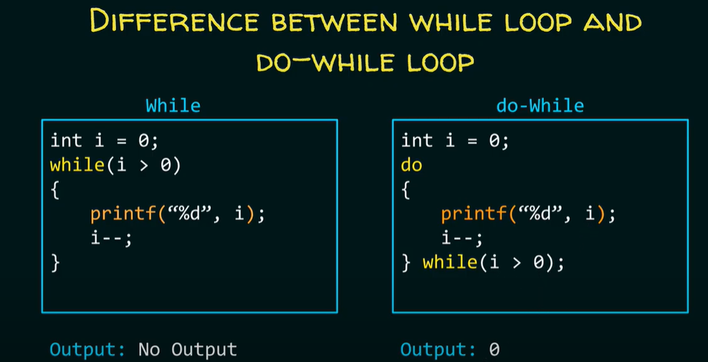

Slide 41
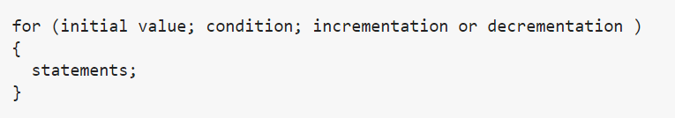
Control Structures: Loops
Syntax of for Loop:
for loop:
A for loop is a more efficient loop structure in 'C' programming. The general structure of for loop syntax in C is as follows:

Slide 42
Control Structures: Loops
Syntax of for Loop:
for loop:
The initial value of the for loop is performed only once.
The condition is a Boolean expression that tests and compares the counter to a fixed value after each iteration, stopping the for loop when false is returned.
The incrementation/decrementation increases (or decreases) the counter by a set value.

Slide 43
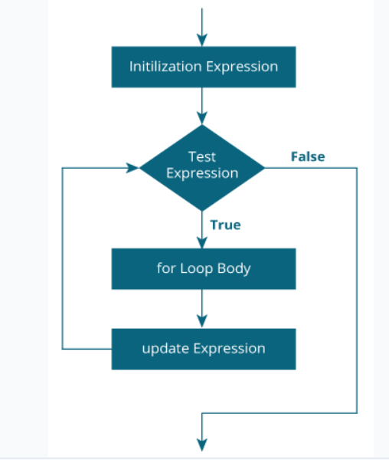
Control Structures: Loops
Flow chart of for Loop:
The initialization statement is executed only once.
Then, the test expression is evaluated. If the test expression is evaluated to false, the for loop is terminated.
However, if the test expression is evaluated to true, statements inside the body of for loop are executed, and the update expression is updated.
Again the test expression is evaluated.

Slide 46
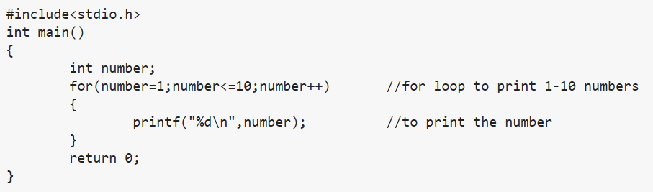
Control Structures: Loops
Syntax of for Loop:
for loop:
Program

Slide 47
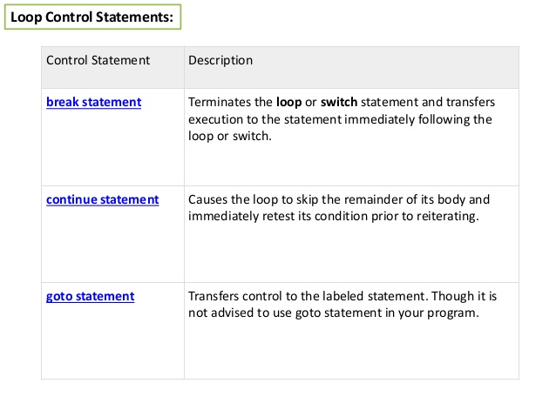
break, continue and goto statements
The break; continue; and goto; statements are used to alter the normal flow of a program.
Loops perform a set of repetitive task until text expression becomes false but it is sometimes desirable to skip some statement/s inside loop or terminate the loop immediately without checking the test expression.
In such cases, break and continue statements are used.

Slide 48
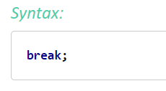
break statement
In C programming, break statement is used with conditional if statement.
The break is used in terminating the loop immediately after it is encountered.

Slide 49
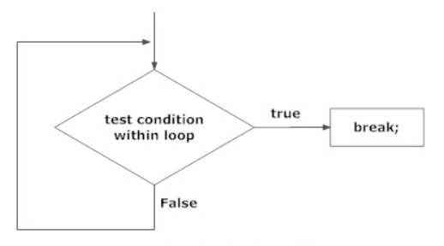
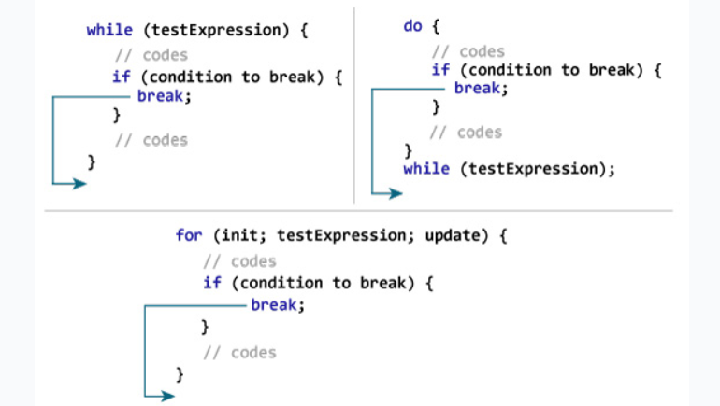
Flowchart for break statement
The break statement can be used in terminating loops like for, while and do...while

Slide 50
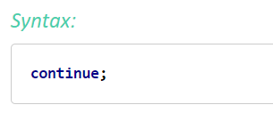
continue statement
It is sometimes desirable to skip some statements inside the loop.
In such cases, continue statement is used.

Slide 51
continue statement
Just like break, continue is also used with conditional if statement.

Slide 52
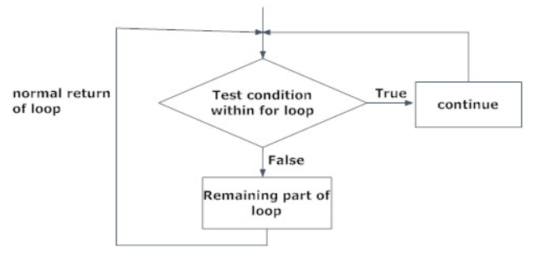
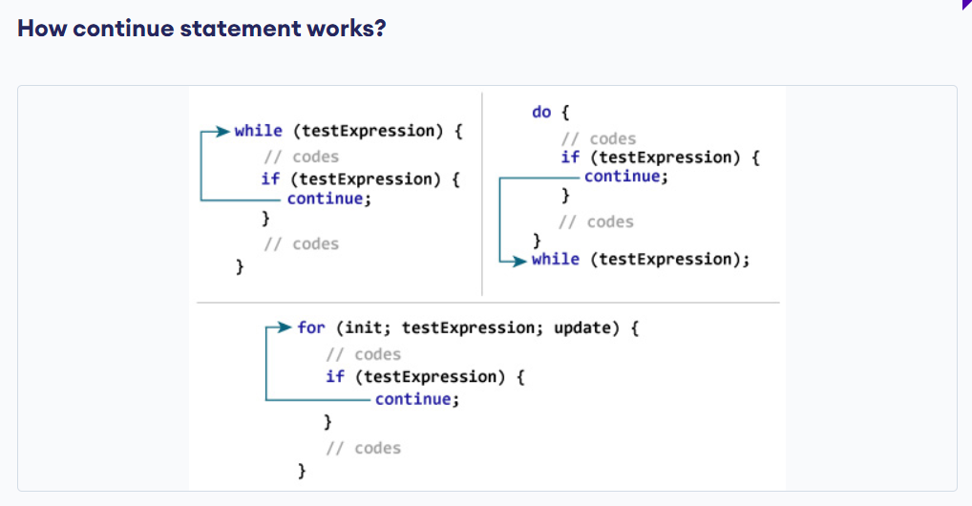
continue statement

Slide 53
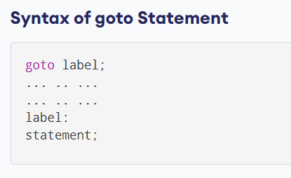
C goto Statement
The goto statement allows us to transfer control of the program to the specified label.

Slide 54
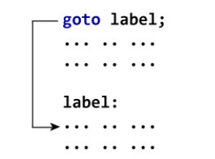
C goto Statement
The label is an identifier.
When the goto statement is encountered, the control of the program jumps to label: and starts executing the code.

Slide 55
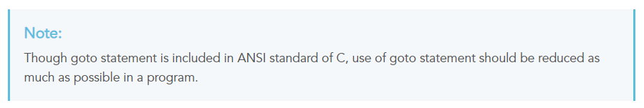
Reasons to avoid goto statement
Though, using goto statement give power to jump to any part of program, using goto statement makes the logic of the program complex and tangled.
In modern programming, goto statement is considered a harmful construct and a bad programming practice.
The goto statement can be replaced in most of C program with the use of break and continue statements.
In fact, any program in C programming can be perfectly written without the use of goto statement.
All programmer should try to avoid goto statement as possible as they can.

Slide 56
Continue Statement
Program

Slide 57
goto Statement
Program

Slide 58
Structured Programming | Unstructured Programming
It is basically a subset of procedural programs. | It is basically a procedural program.
In this, programmers are allowed to code a program simply by dividing the program into modules or smaller units. | In this, programmers are not allowed code divide programs into small units. Instead, the program should be written as a single continuous block without any breakage.
It is more user-friendly and easy to understand as compared to unstructured programming. | It is less user-friendly and little hard to understand as compared to structured programming.
It is easier to learn and follow. | It is difficult to learn and follow
Its advantages include reduce complexity, facilitate debugging, increase programmer productivity programs, etc. | Its advantages include its speed.
Such programs can be used for small and medium-scale projects and also for complex projects. | Such programs cannot be used for medium and complex projects. Instead, they can be used for small and easier projects.
These programs do not allow code duplication. | These programs allow code duplication.
Structured programs use a greater number of data types as compared to unstructured programs. | Unstructured programs use a limited number of data types as compared to structured programs.
It does not use GOTO to control the flow of execution. Instead, it uses loops. | It uses GOTO to control the flow of execution.
It produces readable code. | It hardly produces readable code.
It does not provide full freedom to programmers to program as they want. | It provides full freedom to programmers to program as they want.

Slide 59
Thank You!

